Slide 1
Improve Your Online Presence
Why you should consider marketing your practice online.

Slide 2
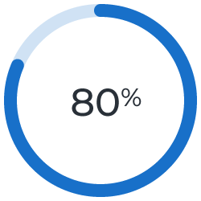
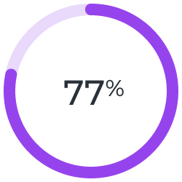
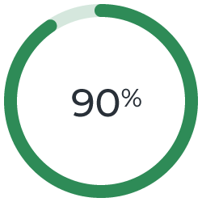
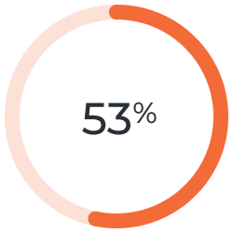
Why Online Marketing
People are online now more than ever and are searching for health information as well as physician information, even if they have been referred by word of mouth.
of internet users have searched for health-related topics online¹
of people research online before booking an appointment²
of people search a physician online before making an appointment³
of Americans say the internet has been essential during the COVID-19 outbreak⁴

Slide 3
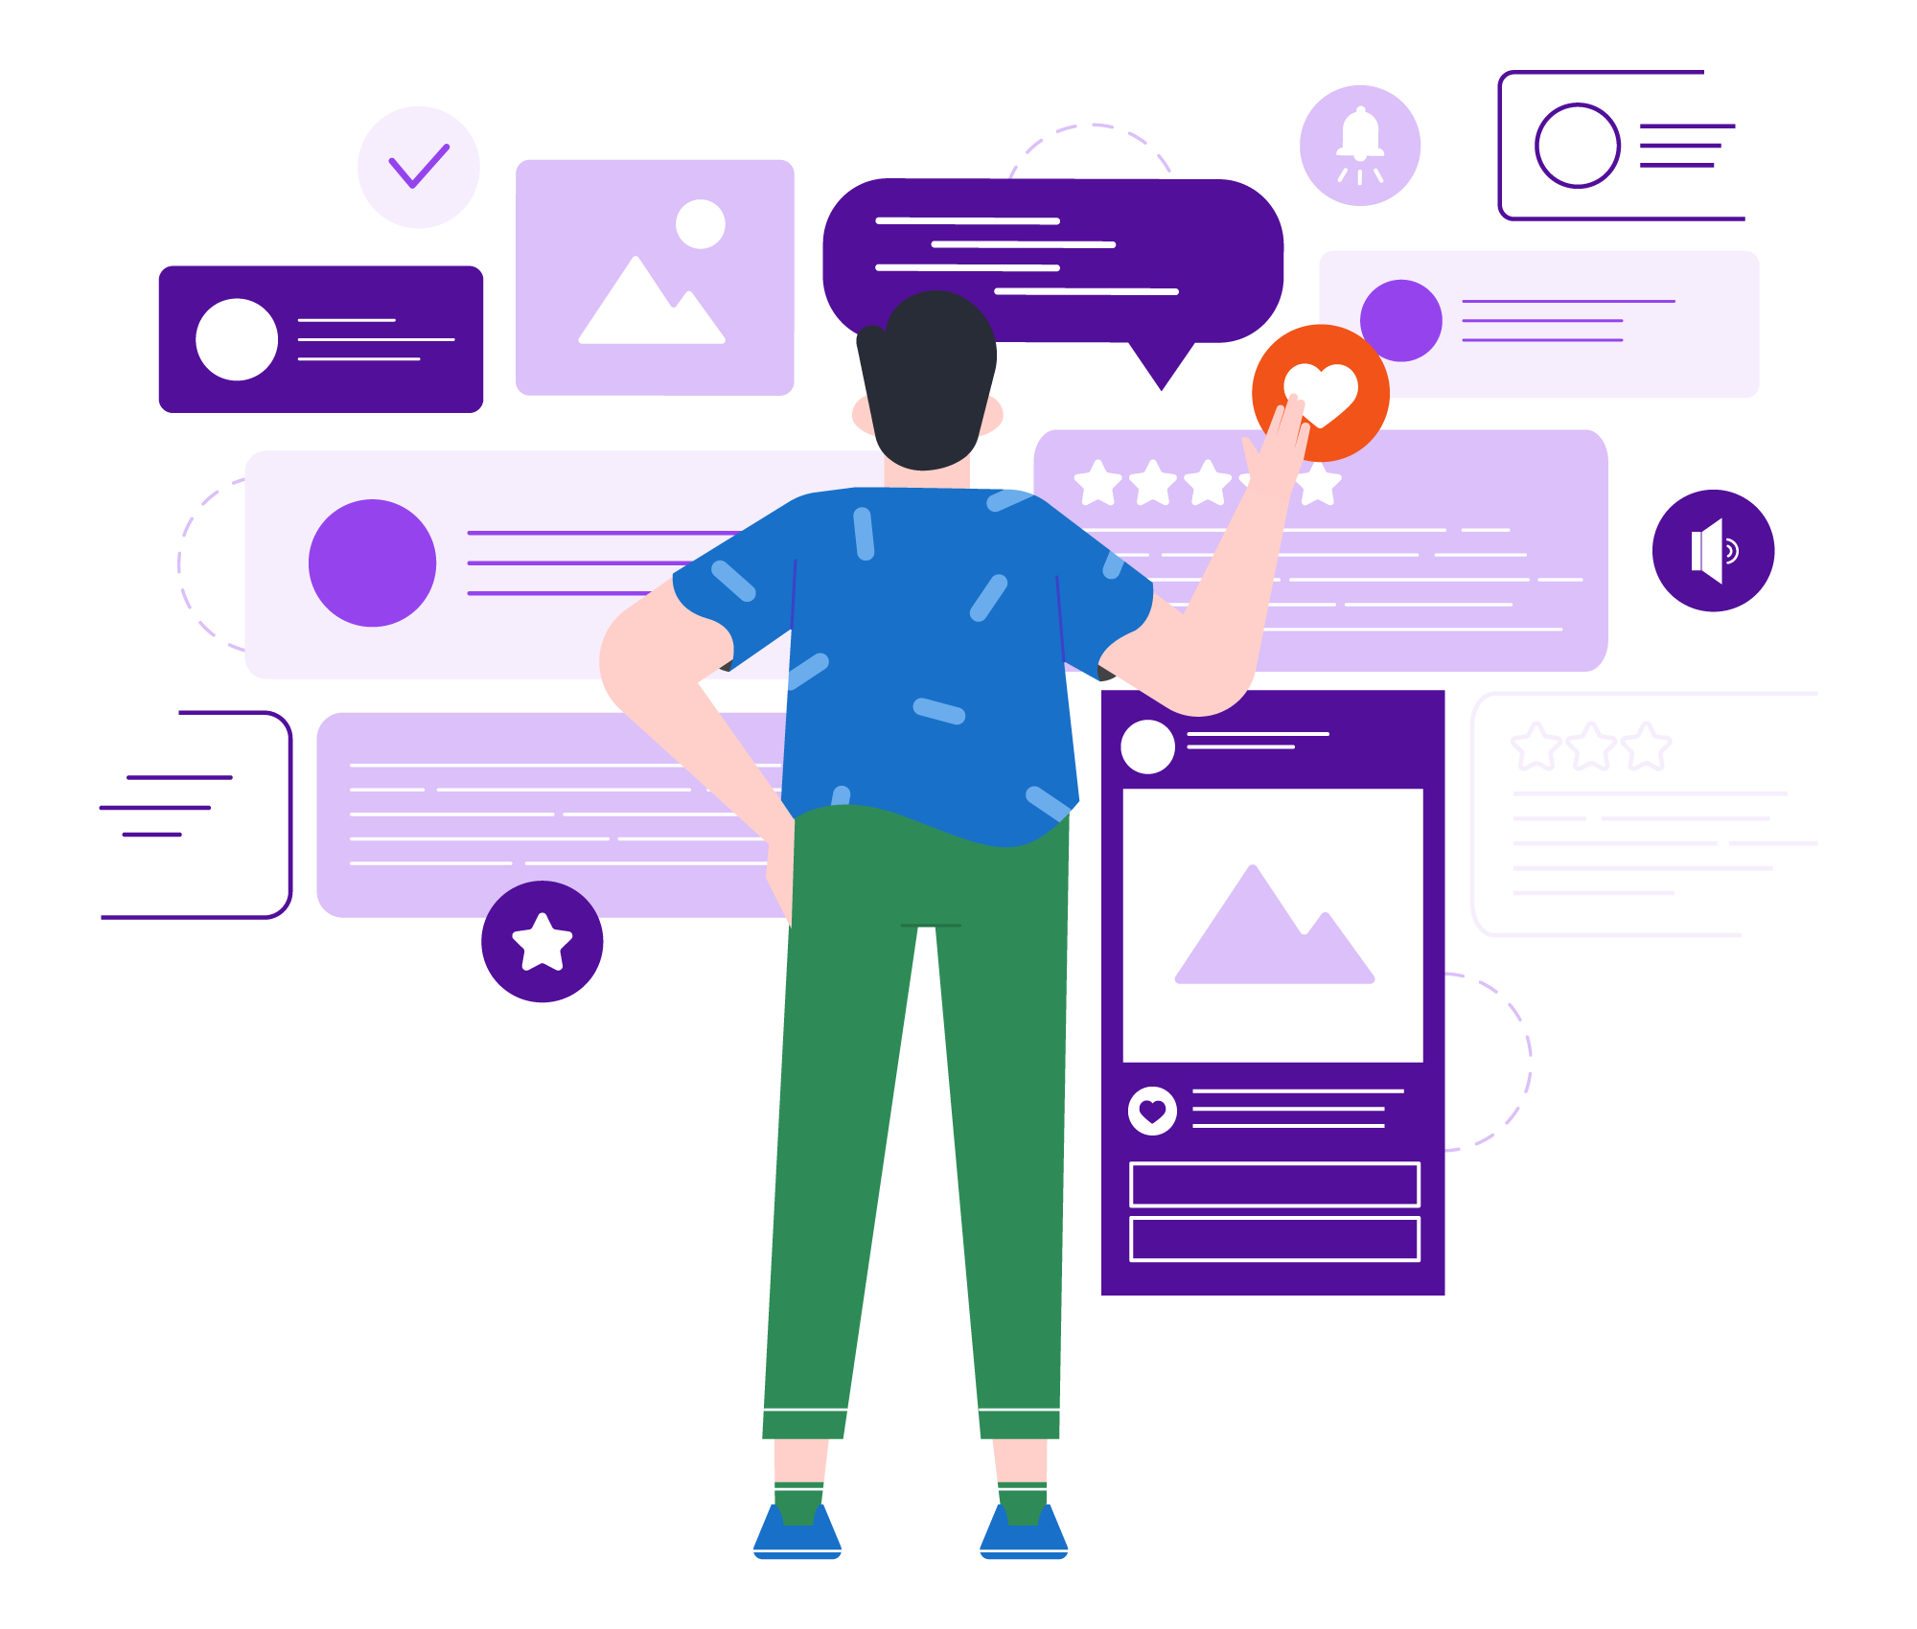
Online Marketing Presence
Patients are searching online to find information about a doctor, even when referred by friends and family. If your practice does not have an effective online presence, you could miss out on building trust with those patients.
Your online presence consists of:
Website
Search Engine Visibility (organic and paid)
Review Sites
Social Media (organic and paid)

Slide 4
Patient Pathways
Social Media
Ads
Search Engine
Ranking
Social Media
Posts
Your
Practice
Patients follow different pathways to finding and contacting a practice online. The more of these pathways that your practice can effectively serve, the better off you’ll be.
Online
Reviews
Google
Ads

Slide 5

Attract Patients Online
You can attract patients online in a variety of ways:
WEBSITE
REPUTATION MARKETING
ADVERTISING (Google & Social Media)
SOCIAL MEDIA

Slide 6

Create a professional web presence that attracts the right patients.

Slide 7
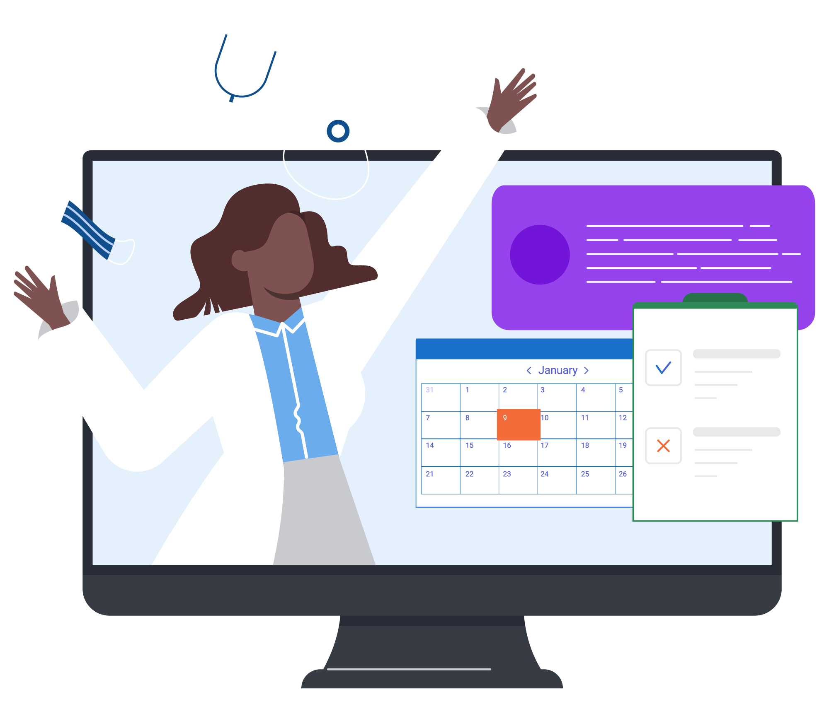

The goal in having an effective online presence for your practice is to get in front of patients who are searching for a doctor online. Your website should:
Include valuable unique content about your procedures and services
Offer patients a way to make an appointment
Provide patients with accurate educational information
Comply with HIPAA and ADA guidelines
The right website and SEO strategy will help your practice show up in relevant searches to attract patients.

Slide 8

Content Marketing
Your content also helps you attract the right patients. It shows that you are knowledgeable and an expert in your field, which improves your chances of ranking for relevant searches. Effective SEO (search engine optimization) will help drive traffic to your site, and help build trust with potential patients.
Well-written, original content helps you show up in relevant searches and also conveys your expertise to potential patients.
Search engines drive 3 times as many visitors to hospital websites than other sources.⁵

Slide 9
Online Appointment Forms
When patients get to your website, make sure they can find the information they need to feel comfortable booking an appointment. Offer patients a way to make an appointment from your website to make it easy for them to interact with your practice.
Makes it easy for patients to engage with your practice
Provides metrics for ROI

Slide 10
Educate Patients to Set Expectations
& Improve Outcomes
Providing your patients with accurate information allows them to better understand their condition or procedure and also positions you as a trusted resource.
Setting appropriate patient expectations through educational content on your website can improve patient satisfaction.^{6,7}
Improve patient outcomes through patient education.⁸

Slide 11

Target the Right Audience with Online Advertising

Slide 12
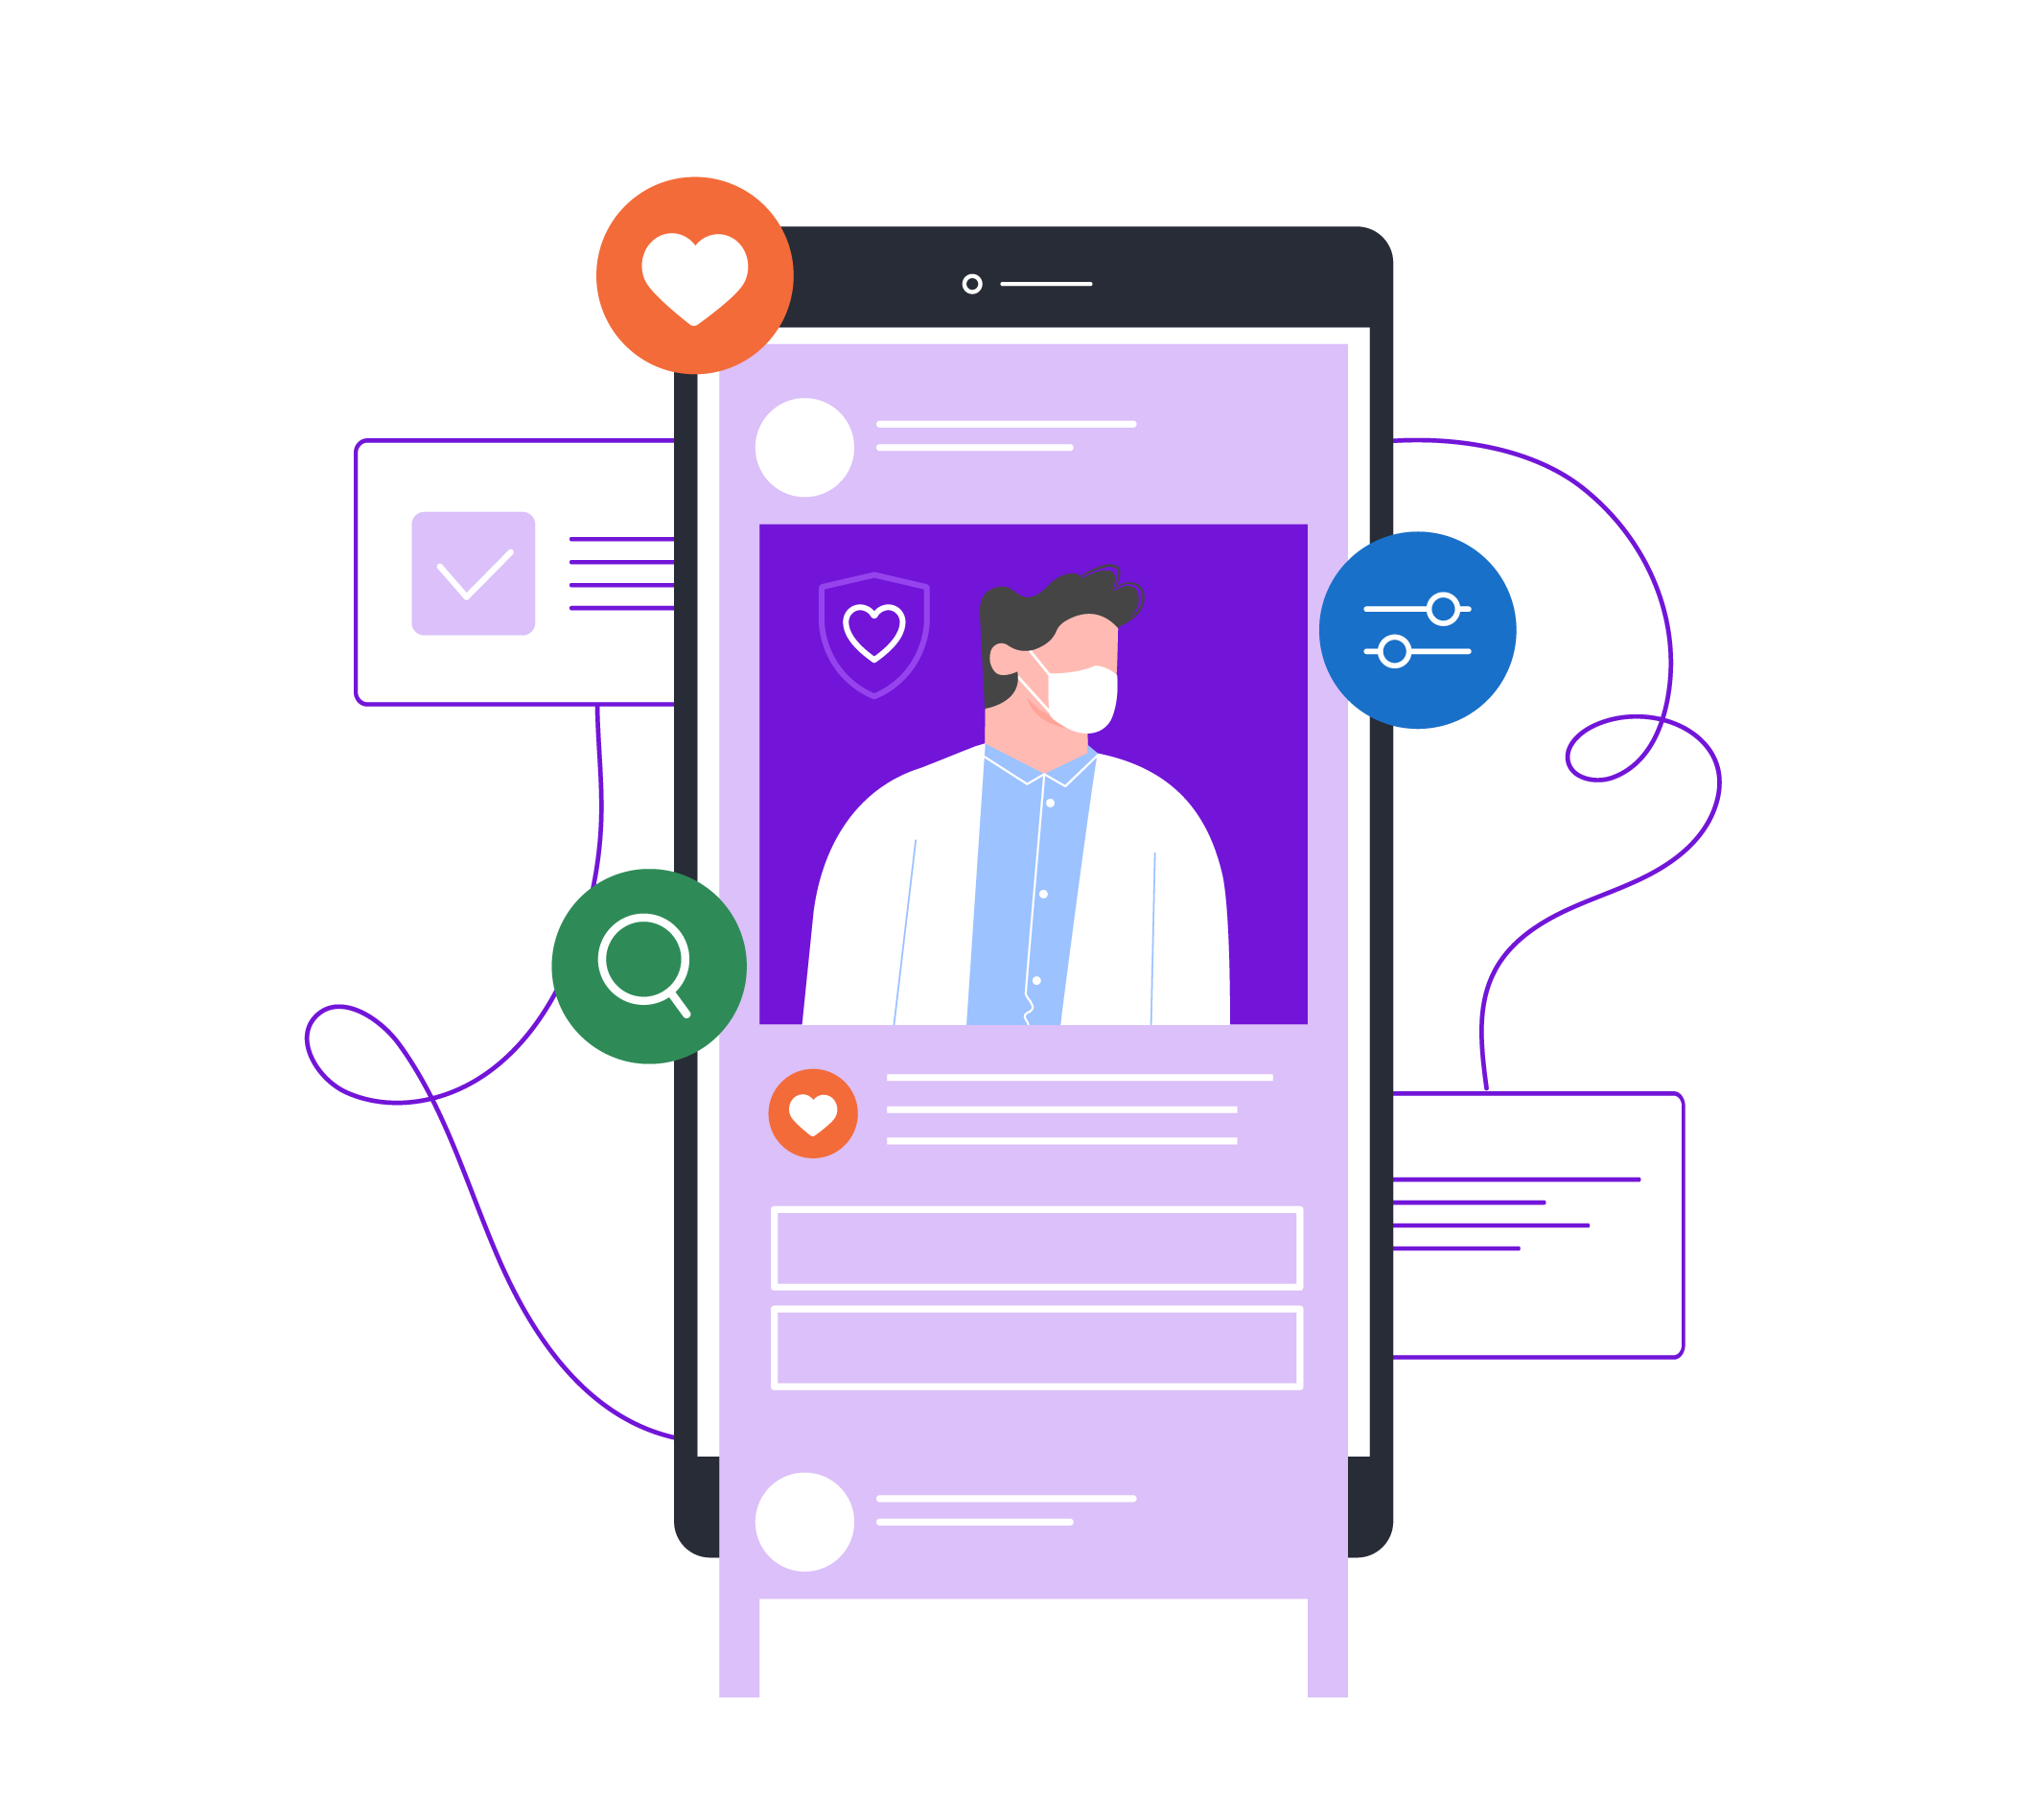

Paid ads help get your message out to prospective patients seeking procedures and services.
Google and Facebook allow you to display ads to a targeted audience. Targeting ensures better qualified leads for your practice.
A paid ad campaign is a quick way to drive traffic to your website. Results are immediate.
Facebook ads work well to increase awareness.
Google ads can help your practice increase appointment requests.

Slide 13
Online Advertising
75% of people say paid search ads make it easier to find the information they are searching for on a website or search engine.¹⁰
About 65% of people click on a sponsored link when looking for health information.⁹
One-third of people (33%) click on a paid search ad because it directly answers their search query.¹¹
Businesses make an average of $8 in income for every $1 they spend in Google Ads.¹²

Slide 14

Influence Your Online Reputation

Slide 15

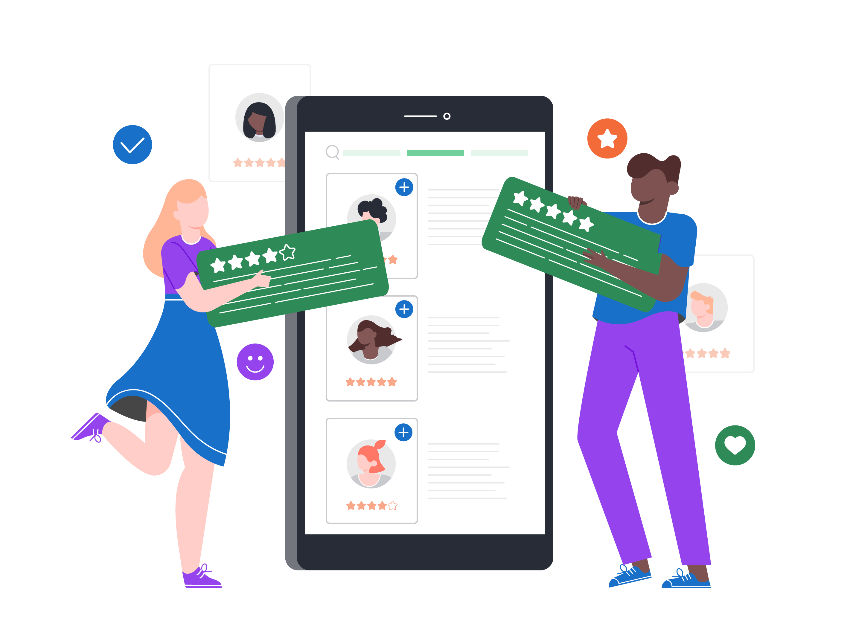
Reputation Marketing helps your practice build up more positive online reviews. This can not only help to boost your search engine ranking, but also may help you get more appointments when patients see your great reviews.
34% of internet users, or 25% of adults, have read someone else’s commentary or experience about health or medical issues on an online news group, website, or blog.¹³
When patients have positive stories to share about your practice, it helps to reassure other patients who are considering scheduling an appointment.

Slide 16

Build Patient Connections on Social Media

Slide 17

With the power of social networking sites, you can build audiences, attract prospective patients, and get people talking about your practice. Social media allows you to connect with patients and help you build trust and confidence with patients.
of internet users are on social media.¹⁴
74%
41%
60%
of people said social media would affect their choice of a specific doctor, hospital or medical facility.¹⁶
of people who use social media trust posts by their doctors.¹⁵

Slide 18


Summary
Your website should be an educational resource for patients and showcase your expertise with your key procedures or treatments. But most importantly, it should help you acquire new patients.

Slide 19
Sources
Pew Internet Project, 2013.
Beckers Hospital Review, https://www.beckershospitalreview.com/hospital-management-administration/how-first-impressions-online-affect-patient-acquisition-and-hospital-revenue.html
Patient Engagement Hit, https://patientengagementhit.com/news/assessing-how-healthcare-consumers-access-doctors-appointments#:~:text=Ninety%20percent%20of%20patients%20are,patient%20engagement%20technology%20firm%20Kyruus.
Pew Research, 2020. https://www.pewresearch.org/internet/2020/04/30/53-of-americans-say-the-internet-has-been-essential-during-the-covid-19-outbreak/
Think with Google Study, http://snip.ly/plozd2#https://www.thinkwithgoogle.com/advertising-channels/search/the-digital-journey-to-wellness-hospital-selection/
Pubmed, https://pubmed.ncbi.nlm.nih.gov/16967035/
JOA, https://www.arthroplastyjournal.org/article/S0883-5403(19)30002-6/abstract
NIH, https://www.ncbi.nlm.nih.gov/pmc/articles/PMC5242136/
Wordstream.com, 2019. https://www.wordstream.com/blog/ws/2012/07/17/google-advertising
B2C Brandviews, 2019. https://www.business2community.com/brandviews/shelley-media-arts/80-seo-sem-statistics-that-prove-the-power-of-search-2019-update-02251024
Clutch.com, 2018. https://clutch.co/seo-firms/resources/search-engine-marketing-why-people-click-paid-search-ads#:~:text=People%20click%20on%20paid%20search%20advertisements%20that%20provide%20relevant%20responses,searches%20to%20find%20specific%20information.
Google Economic Impact Report., 2018. https://kstatic.googleusercontent.com/files/ed56d1f0ea72190c83db9077931ab69a53406ce48b0621788e53b05c909b5e4e358d80b90976f9224368866edc00de1e36c3fb89c569b2452bf20a352500f5c4
Pew Research, 2011. https://www.pewresearch.org/internet/2011/05/12/the-social-life-of-health-information-2011/
Pew Research Center, 2019. https://www.pewresearch.org/internet/fact-sheet/social-media/
https://whprms.org/11-health-care-social-media-stats-to-turn-heads/
Demi & Cooper Advertising and DC Interactive Group, https://thesparkreport.com/infographic-social-mobile-healthcare/

